Slide 1

Chapter 1 Marketing: Creating and Capturing Customer Value
i t ’s good and
good for you
Copyright © 2012 Pearson Education, Inc.
Publishing as Prentice Hall
1- 1

Slide 2

Creating and Capturing Customer Value
Topic Outline
What Is Marketing?
Understand the Marketplace and Customer Needs
Designing a Customer-Driven Marketing Strategy
Preparing an Integrated Marketing Plan and Program
Building Customer Relationships
Capturing Value from Customers
The Changing Marketing Landscape
Copyright © 2012 Pearson Education, Inc.
Publishing as Prentice Hall
1- 2

Slide 3
What Is Marketing?
Marketing is a process by which companies create value for customers and build strong customer relationships to capture value from customers in return
Copyright © 2012 Pearson Education, Inc.
Publishing as Prentice Hall
1- 3
Notes:
Discussion Question
Ask students for examples of either national or local companies that are excellent at marketing and ask how they reflect the definition given in this slide.

Slide 4
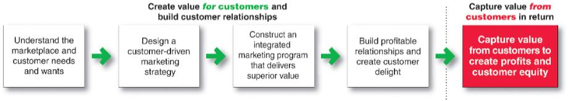
What Is Marketing?
The Marketing Process
Copyright © 2012 Pearson Education, Inc.
Publishing as Prentice Hall
1- 4
Notes:
This important figure shows marketing in
a nutshell! By creating value for customers,
marketers capture value from customers in
return. This five-step process forms the
marketing framework for the rest of
the chapter and the remainder of the book.

Slide 5
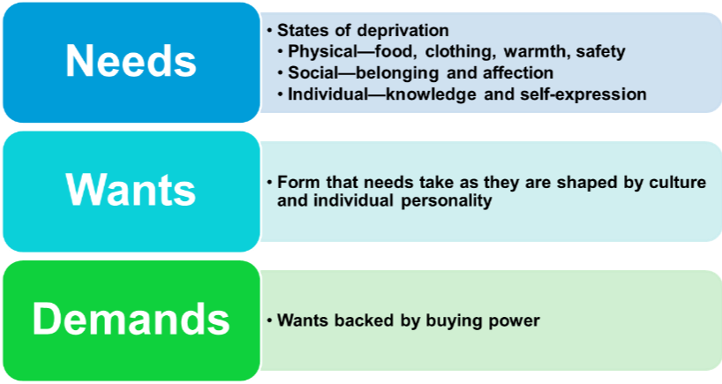
Understanding the Marketplace and Customer Needs
Customer Needs, Wants, and Demands
Copyright © 2012 Pearson Education, Inc.
Publishing as Prentice Hall
1- 5

Slide 6

Understanding the Marketplace and Customer Needs
Market offerings are some combination of products, services, information, or experiences offered to a market to satisfy a need or want
Marketing myopia is focusing only on existing wants and losing sight of underlying consumer needs
Copyright © 2012 Pearson Education, Inc.
Publishing as Prentice Hall
1- 6

Slide 7
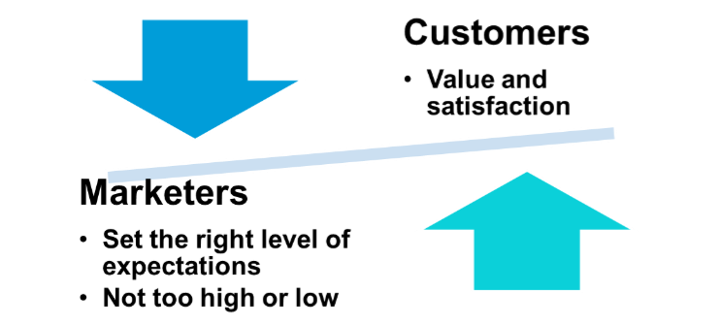
Understanding the Marketplace and Customer Needs
Customer Value and Satisfaction
Expectations
Copyright © 2012 Pearson Education, Inc.
Publishing as Prentice Hall
1- 7
Notes:
Ask students what online retailers deliver exceptional value and satisfaction.
Discussion Question
Why do marketer’s not always understand customer needs? How can they better identify customer needs?
Marketer’s often work in a vacuum and do not consider the customer’s needs as much as they should. Future chapters will talk about market research and marketing information, important tools for understanding customer’s needs. Students might be familiar with survey research or focus groups as techniques for gathering information or they might be asked for their zip code when they purchase in certain retailers

Slide 8
Understanding the Marketplace and Customer Needs
Exchange is the act of obtaining a desired object from someone by offering something in return
Copyright © 2012 Pearson Education, Inc.
Publishing as Prentice Hall
1- 8
Notes:
Marketing consists of actions taken to build and maintain desirable exchange relationships with target audiences involving a product, service, idea, or other object.
Beyond simply attracting new customers and creating transactions, the goal is to retain customers and grow their business with the company.

Slide 9
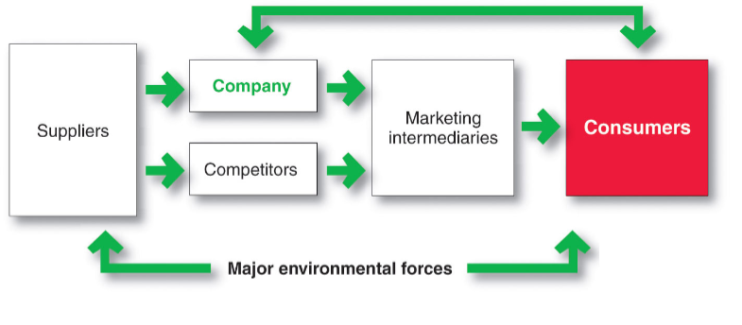
Understanding the Marketplace and Customer Needs
Markets are the set of actual and potential buyers of a product
Copyright © 2012 Pearson Education, Inc.
Publishing as Prentice Hall
1- 9
Notes:
Arrows represent relationships
that must be developed and
managed to create customer
value and profitable customer
relationships.

Slide 10
Designing a Customer-Driven Marketing Strategy
Marketing management is the art and science of choosing target markets and building profitable relationships with them
What customers will we serve?
How can we best serve these customers?
Copyright © 2012 Pearson Education, Inc.
Publishing as Prentice Hall
1- 10
Notes:
Now that the company
fully understands its
consumers and the marketplace, it
must decide which customers it will
serve and how it will bring them value.

Slide 11
Designing a Customer-Driven Marketing Strategy
Selecting Customers to Serve
Market segmentation refers to dividing the markets into segments of customers
Target marketing refers to which segments to go after
Copyright © 2012 Pearson Education, Inc.
Publishing as Prentice Hall
1- 11

Slide 12
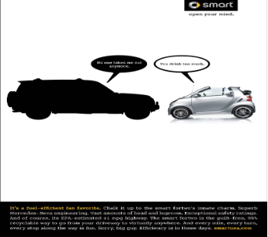
Designing a Customer-Driven Marketing Strategy
Choosing a Value Proposition
Value proposition Set of benefits or values a company promises to deliver to customers to satisfy their needs
Copyright © 2012 Pearson Education, Inc.
Publishing as Prentice Hall
1- 12

Slide 13
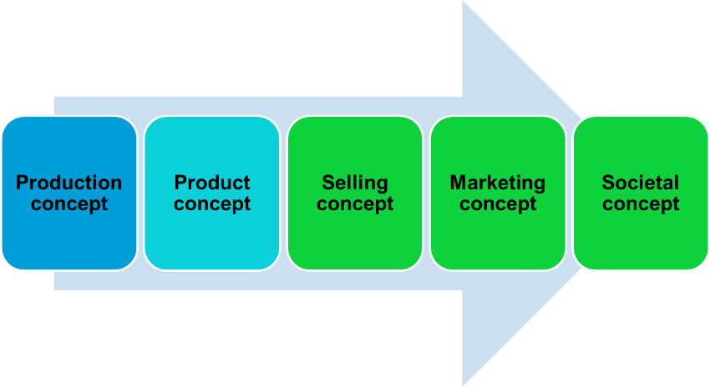
Designing a Customer-Driven Marketing Strategy
Marketing Management Orientations
Copyright © 2012 Pearson Education, Inc.
Publishing as Prentice Hall
1- 13

Slide 14
Designing a Customer-Driven Marketing Strategy
Marketing Management Orientations
Production concept is the idea that consumers will favor products that are available or highly affordable
Copyright © 2012 Pearson Education, Inc.
Publishing as Prentice Hall
1- 14

Slide 15
Designing a Customer-Driven Marketing Strategy
Marketing Management Orientations
Product concept is the idea that consumers will favor products that offer the most quality, performance, and features. Organization should therefore devote its energy to making continuous product improvements.
Copyright © 2012 Pearson Education, Inc.
Publishing as Prentice Hall
1- 15

Slide 16
Designing a Customer-Driven Marketing Strategy
Marketing Management Orientations
Selling concept is the idea that consumers will not buy enough of the firm’s products unless it undertakes a large scale selling and promotion effort
Copyright © 2012 Pearson Education, Inc.
Publishing as Prentice Hall
1- 16

Slide 17

Designing a Customer-Driven Marketing Strategy
Marketing Management Orientations
Marketing concept is the idea that achieving organizational goals depends on knowing the needs and wants of the target markets and delivering the desired satisfactions better than competitors do
Copyright © 2012 Pearson Education, Inc.
Publishing as Prentice Hall
1- 17

Slide 18
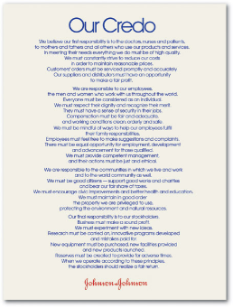
Designing a Customer-Driven Marketing Strategy
Marketing Management Orientations
Societal marketing concept is the idea that a company should make good marketing decisions by considering consumers’ wants, the company’s requirements, consumers’ long-term interests, and society’s long-run interests
Copyright © 2012 Pearson Education, Inc.
Publishing as Prentice Hall
1- 18
Notes:
Discussion Questions
What companies can you identify with social Marketing?
What do these companies do that ties to the societal marketing concept?
Students might be familiar with many different companies that practice societal marketing through their Corporate Social Responsibility (CSR) initiatives. Students might be familiar with local retailers who are also involved in societal marketing. (Target, TOMS shoes). They will note that these companies donate, contribute, or offer services to charities and not-for-profit organizations.

Slide 19
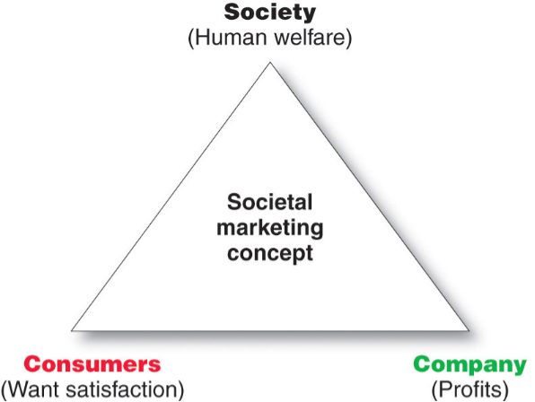
Designing a Customer-Driven Marketing Strategy
Copyright © 2012 Pearson Education, Inc.
Publishing as Prentice Hall
1- 19
Notes:
This slide shows companies should balance three considerations in setting their marketing strategies.
Johnson & Johnson does this well. Johnson & Johnson would rather take a big loss than ship a bad batch of one of its products. Consider the tragic tampering case in which eight people died in 1982 from swallowing cyanide-laced capsules of Tylenol, a Johnson & Johnson brand. Although Johnson & Johnson believed that the pills had been altered in only a few stores, they recalled all of their product and launched an information campaign to instruct and reassure consumers. The recall cost the company $100 million in earnings.
In the long run, however, the company’s swift recall of Tylenol strengthened consumer confidence and loyalty, and today Tylenol remains one of the nation’s leading brands of pain reliever.
Discussion Question
Ask students about other companies that have had serious problems with their products? How have these companies bounced back?

Slide 20
Preparing an Integrated Marketing Plan and Program
The marketing mix: set of tools (four Ps) the firm uses to implement its marketing strategy. It includes product, price, promotion, and place.
Integrated marketing program: comprehensive plan that communicates and delivers the intended value to chosen customers.
Copyright © 2012 Pearson Education, Inc.
Publishing as Prentice Hall
1- 20

Slide 21

Building Customer Relationships
Customer Relationship Management (CRM)
The overall process of building and maintaining profitable customer relationships by delivering superior customer value and satisfaction
Copyright © 2012 Pearson Education, Inc.
Publishing as Prentice Hall
1- 21

Slide 22
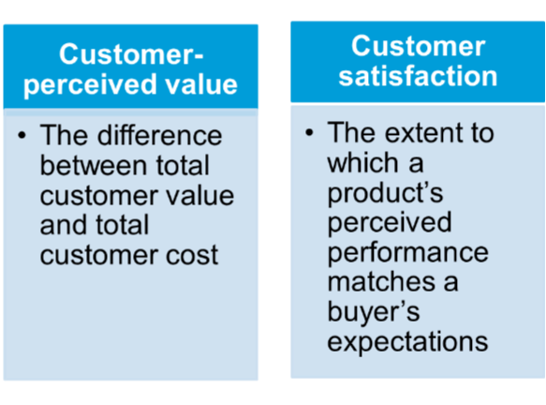
Building Customer Relationships
Relationship Building Blocks: Customer Value and Satisfaction
Copyright © 2012 Pearson Education, Inc.
Publishing as Prentice Hall
1- 22

Slide 23
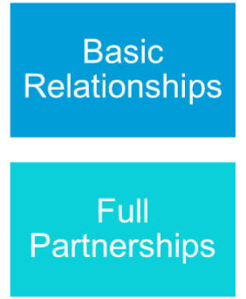
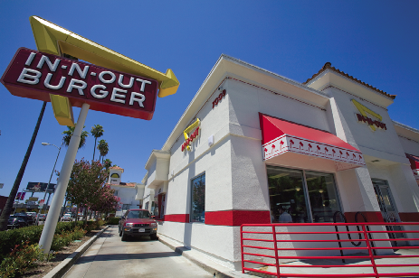
Building Customer Relationships
Customer Relationship Levels and Tools
Copyright © 2012 Pearson Education, Inc.
Publishing as Prentice Hall
1- 23
Notes:
Basic Relationships are often used by a company with many low-margin customers . For example, Procter & Gamble does not phone or call on all of its Tide consumers to get to know them personally. Instead, P&G creates relationships through brand-building advertising, sales promotions, and its Tide FabricCare Network Web site (www.Tide.com).
Full Partnerships are used in markets with few customers and high margins, sellers want to create full partnerships with key customers. For example, P&G customer teams work closely with Wal-Mart, Safeway, and other large retailers.
Discussion Question
Ask students what frequency or club marketing programs they belong to and why?

Slide 24
Building Customer Relationships
The Changing Nature of Customer Relationships
Relating with more carefully selected customers uses selective relationship management to target fewer, more profitable customers
Relating more deeply and interactively by incorporating more interactive two way relationships through blogs, Websites, online communities and social networks
Copyright © 2012 Pearson Education, Inc.
Publishing as Prentice Hall
1- 24
Notes:
Discussion Question
Ask students how marketers have used facebook, myspace, linkedin or other social networks for marketing purposes. Ask them about YouTube and how that has changed marketing.

Slide 25
Building Customer Relationships
The Changing Nature of Customer Relationships
Customer-managed relationships
Marketing relationships in which
customers, empowered by today’s new
digital technologies, interact with
companies and with each other to shape
their relationships with brands.
Copyright © 2012 Pearson Education, Inc.
Publishing as Prentice Hall
1- 25
Notes:
Discussion Question
Ask students how marketers have used facebook, myspace, linkedin or other social networks for marketing purposes. Ask them about YouTube and how that has changed marketing.

Slide 26
Building Customer Relationships
Partner relationship management involves working closely with partners in other company departments and outside the company to jointly bring greater value to customers
Copyright © 2012 Pearson Education, Inc.
Publishing as Prentice Hall
1- 26

Slide 27
Building Customer Relationships
Partner Relationship Management
Partners inside the company is every function area interacting with customers
Electronically
Cross-functional teams
Partners outside the company is how marketers connect with their suppliers, channel partners, and competitors by developing partnerships
Copyright © 2012 Pearson Education, Inc.
Publishing as Prentice Hall
1- 27

Slide 28
Building Customer Relationships
Partner Relationship Management
Supply chain is a channel that stretches from raw materials to components to final products to final buyers
Supply chain management
Copyright © 2012 Pearson Education, Inc.
Publishing as Prentice Hall
1- 28

Slide 29
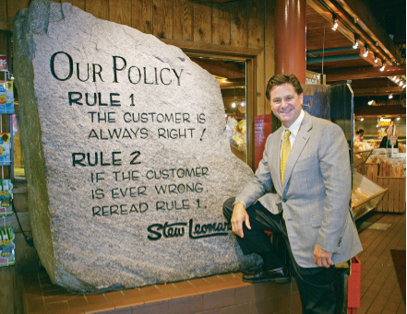
Capturing Value from Customers
Creating Customer Loyalty and Retention
Customer lifetime value is the value of the entire stream of purchases that the customer would make over a lifetime of patronage
Copyright © 2012 Pearson Education, Inc.
Publishing as Prentice Hall
1- 29
Notes:
Stew Leonard’s is an interesting example. Stew Leonard, who operates a highly profitable four-store supermarket in Connecticut and New York, says that he sees $50,000 flying out of his store every time he sees a sulking customer. Why? Because his average customer spends about $100 a week, shops 50 weeks a year, and remains in the area for about 10 years. If the marketing process, the company creates value for target customers and builds strong relationships with them. To keep customers coming back, Stew Leonard’s has created the “Disneyland of dairy stores.” Rule 1—the customer is always right. Rule 2—If the customer is ever wrong, reread Rule 1.
You can find videos of Leonard’s stores on youtube.com which will give the students an idea of the atmosphere.
Discussion Question
Ask students if they know of other retailers build this kind of exciting environment.

Slide 30
Capturing Value from Customers
Growing Share of Customer
Share of customer is the portion of the customer’s purchasing that a company gets in its product categories
Copyright © 2012 Pearson Education, Inc.
Publishing as Prentice Hall
1- 30

Slide 31

Capturing Value from Customers
Customer equity is the total combined customer lifetime values of all of the company’s customers
Copyright © 2012 Pearson Education, Inc.
Publishing as Prentice Hall
1- 31

Slide 32
Capturing Value from Customers
Building Customer Equity
Right relationships with the right customers involves treating customers as assets that need to be managed and maximized
Different types of customers require different relationship management strategies
Copyright © 2012 Pearson Education, Inc.
Publishing as Prentice Hall
1- 32

Slide 33

The Changing Marketing Landscape
Uncertain Economic Environment
New consumer frugality
Marketers focus on value for the customer
Copyright © 2012 Pearson Education, Inc.
Publishing as Prentice Hall
1- 33
Notes:
Target focus changes to the ‘pay less’ part of the slogan, adjusting prices to compete with WalMart.
This is a good slide to prompt discussion on personal observations and experiences.

Slide 34
The Changing Marketing Landscape Digital Age
People are connected continuously to people and information worldwide
Marketers have great new tools to communicate with customers
Internet + mobile communication devices creates environment for online marketing
Copyright © 2012 Pearson Education, Inc.
Publishing as Prentice Hall
1- 34

Slide 35
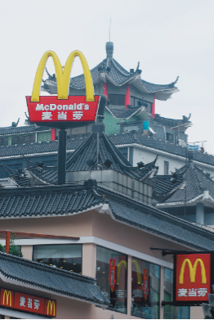
The Changing Marketing Landscape
Rapid Globalization
Sustainable Marketing
Not-for-Profit Marketing
Copyright © 2012 Pearson Education, Inc.
Publishing as Prentice Hall
1- 35

Slide 36
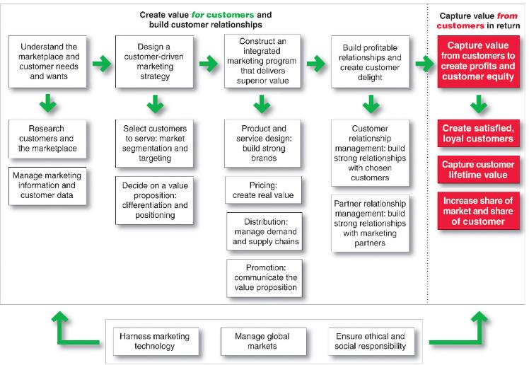
So, What Is Marketing? Pulling It All Together
Copyright © 2012 Pearson Education, Inc.
Publishing as Prentice Hall
1- 36

Slide 37
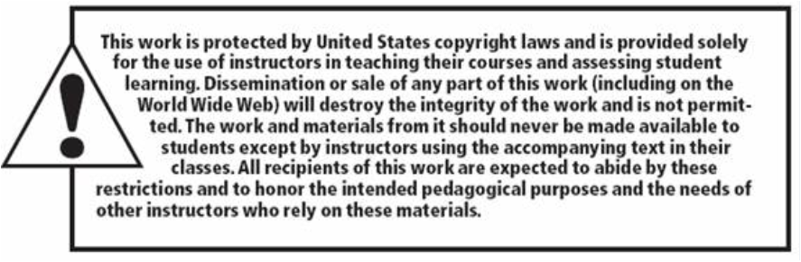
All rights reserved. No part of this publication may be reproduced, stored in a retrieval system, or transmitted, in any form or by any means, electronic, mechanical, photocopying, recording, or otherwise, without the prior written permission of the publisher. Printed in the United States of America.
Copyright © 2012 Pearson Education, Inc.
Publishing as Prentice Hall
Copyright © 2012 Pearson Education, Inc.
Publishing as Prentice Hall
1- 37

